Slide 1
My Portofolio
Showcase
Data Science

Slide 2




BURHAN RAFID EKATAMA
26 years old
Brawijaya University
Agroindustrial Engineering (2015 2019)
I have strong passion for uncovering insights and driving data-informed decisions. With expertise in data visualization using Google Looker Studio and Tableau, as well as proficiency in Python and SQL programming, I am dedicated to transforming complex data into visually compelling stories that empower stakeholders to make informed decisions. I am highly adept at analyzing large datasets to identify patterns, trends, and correlations.
https://www.linkedin.com/in/burhanrafidekatama/
b.rafidekatama@gmail.com
https://github.com/RapidEkatama

Slide 3
01
02
03
Work
Experience
Machine Operator
PT. Tjiwi Kimia
Jan 2021 – Sept 2021
Production Supervisor Shift
PT. Ultra Prima Abadi
Sept 2021 – Sept 2022
Production Line Leader
PT. Smoore Technology Indonesia
Sept 2022 – Feb 2023
Operate the adhesive making machine
Responsible for the result of Carton Board related to adhesive used
Measure and report man power affectiveness in Glue Kitchen Work Division
Measure quality of the starch material
Conducting material receipt and organizing the area part
Mapping and inline person management of more than 40 people.
Maintaining a minimum production target of 80 percent.
Checking and monitoring the entire production process.
Performing OEE calculations for each shift.
Analyze constraints during production.
Calculate production estimated target (around 70.000 pcs) and material requirement.
Input production data recap and write report on production results in one shift.
Correct the engine production time until it decreases by 2 seconds.
Reducing the effects of machine downtime by supporting machine repairs or line shifts.

Slide 4
Course
Course
And
Project
Data Science Bootcamp by dibimbing.id (January – July 2023)
Learn about how to become Data Scientist
Python and SQL programming language
Data cleaning and manipulation
Dashboard using Google Looker Studio
Exploratory Data Analysis
Machine Learning (Supervised and Unsupervised)
Becoming Profesional Virtual Assistant by habiskerja (August 2023)
VA basic tools
Email Management
Event Planning, Meeting, Calendar Management
Basic Data Analyst Package Course by codingstudio (Ongoing)
Fundamental of Excel
Fundamental of Python Programming Language
Fundamental Algorithm

Slide 5
Project
Course
And
Project
World Most Deadly Disease
Heart disease become the first killer in the world with various symptoms and causes
Objective : is to predict the patient got heart disease or not. So in the future this disease can be decreased.
Link Project
Do You Get Panic Now?
The last few years, Mental illness (anxiety) become increased and become a topic of conversation
Objective : is to predict the patient got Panic attack or not. So in the future this mental illness can be overcome and handled professionally.
Link Project

Slide 6
World Most Deadly Disease
Burhan Rafid Ekatama

Slide 7
01
PROBLEM OVERVIEW
-----------------------------------------------------------------------------------------
02
DATA UNDERSTANDING
Content
-----------------------------------------------------------------------------------------
03
MODELLING AND RECOMMENDATION
-----------------------------------------------------------------------------------------
04
QUESTION AND SOCIETY INSIGHT
-----------------------------------------------------------------------------------------

Slide 8
Problem Overview
And
Data Understanding

Slide 9
Problem Overview
Heart disease describes a range of conditions that affect the heart. Heart diseases include Blood vessel disease, such as coronary artery disease, Irregular heartbeats (arrhythmias),
Based on cdc.gov, there are number of deaths for leading causes of death
Heart problems born with (congenital heart defects), Disease of the heart muscle, Heart valve disease
1. Heart Disease
2. Cancer
3. COVID - 19
4. Accidents
5. Stroke
6. Chronic Lower Respiratory Disease

Slide 10
Problem Overview
Total Respondents
70.000 person
Positive and Negative
Goals
Hope
35021 Person, Negative
34979 Person, Positive
Predict best model for patients who are suspected of having Heart Disease or not
Can reduce the risk of death from heart disease and can detect early from the symptoms of the disease

Slide 11
Data Understanding
13 Columns (id, age, gender, height, weight, ap_hi, ap_lo, cholesterol, gluc, smoke, alco, active, cardio)
70.000
Respondents
Encoding and deleting column “ID”
Columns Relabelling
13 Columns (Age, Height, Weight, Sys_Blood_Press, Dias_Blood_Press, Cholesterol, Glucose, Smoking, Alcoholic, Physical Activity, Cardio Diagnose, Gender_A_Female, Gender_A_Male)
Missing and duplicated value checking
Delete the row with unreasonable values
(By Multivariate analysis (Correlation), all of variables there is not have a high value (> 0,8), except Systole and Diastole Blood Pressure)
68.816
Respondents

Slide 12
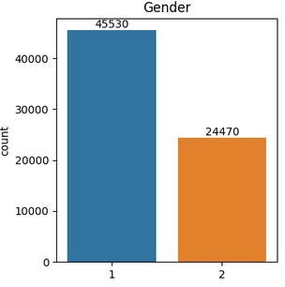
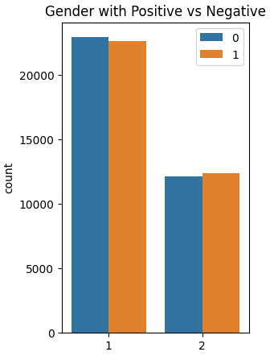
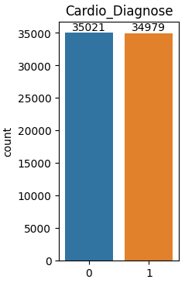
Data Understanding
N
P
From table beside, the negative and positive respondents is nearly balanced
50.03 % on Negative
and
49.97 % on Positive
count
Female Male
From table above, the
Female respondents higher than Male respondents
But, If each Gender separate by positive or negative diagnose, it has nearly result.
Female Male
Negative Positive

Slide 13
Modelling and Recommendation

Slide 14
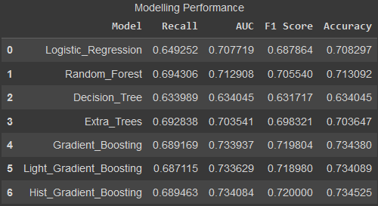

Modelling
Modelling Result
Based on tabel beside, it can be concluded that the best model is Hist Gradient Boosting
Highest Accuracy Value (0.7345)
Highest F1 Score Value (0.72)
The Recall value on Hist Gradient Boosting is 0.689, meaning that out of 100 person were tested, about 68 – 69 person get into Heart Disease

Slide 15
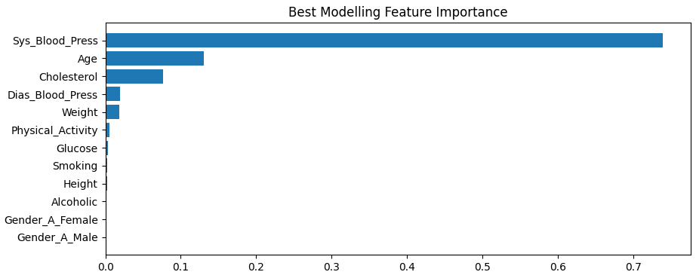
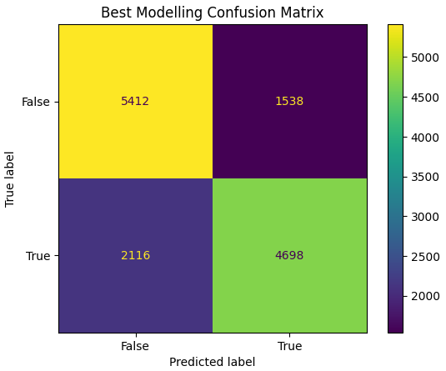
Modelling
Modelling Result
Based on tabel above, it can be concluded that the most common cause of heart disease is Systole Blood Pressure, Age, and Cholesterol rate

Slide 16
Question
And
Society Insight

Slide 17
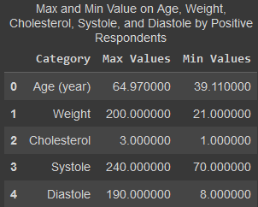
Some Questions
Question 1
From people with Heart Disease, how many on maximum and minimum point for the priority? So we can give more attention into it
From table beside, we know that all of positive respondent were in middle-aged, and a wide range of weight, Systole rate, and Diastole rate.
Everyone has the possibility of this disease

Slide 18
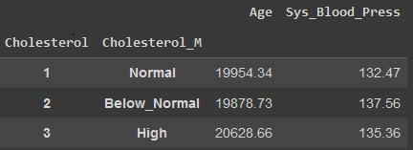
Some Questions
Question 2
Separated by cholesterol (most common cause of narrowing of the arteries), how mean of the Age and Systole?
From table beside, from all of positive Heart Disease respondents we know that on normal cholesterol rate, has the mean age is 19954,34 days (54+ years old) and mean Systole is 132.47. On high cholesterol rate, has the mean age is 20628.66 days (56+ years old) and mean Systole is 135.36
So we can conclude that person is 54 years old and above, with high Systole (standard value is 120) has a high risk of heart disease

Slide 19
Society
Insight
Heart disease describes a range of conditions that affect the heart. Heart diseases include:
Blood vessel disease, such as coronary artery disease
Irregular heartbeats (arrhythmias)
Heart problems you're born with (congenital heart defects)
Disease of the heart muscle
Heart valve disease
Many forms of heart disease can be prevented or treated with healthy lifestyle choices.
mayoclinic.org

Slide 20
Society
Insight
Coronary artery disease is a common heart condition that affects the major blood vessels that supply the heart muscle. Cholesterol deposits (plaques) in the heart arteries are usually the cause of coronary artery disease.
Symptoms of coronary artery disease can include chest pain, chest tightness, chest pressure and chest discomfort (angina), shortness of breath, pain in the throat, upper belly area or back, weakness or coldness in the legs or arms if the blood vessels in those body areas are narrowed
Risk factors for heart disease include:
Age, sex, family history, smoking, unhealthy diet, high blood pressure, high cholesterol, diabetes, obesity, lack of exercise, stress
mayoclinic.org

Slide 21
Society
Insight
There is some tips which you can use to prevention the heart disease:
Don't smoke.
Eat a diet that's low in salt and saturated fat.
Exercise at least 30 minutes a day on most days of the week.
Maintain a healthy weight.
Reduce and manage stress.
Control high blood pressure, high cholesterol and diabetes.
Get good sleep. Adults should aim for 7 to 9 hours daily.
Based on the best model chosen, it is hoped that it can more quickly detect a person or patient who is suspected of having a Heart Disease. Because the faster the first treatment of a patient can increase the percentage of recovery from that patient.
mayoclinic.org

Slide 22
References
https://www.cdc.gov/nchs/fastats/leading-causes-of-death.html
https://www.mayoclinic.org/diseases-conditions/heart-disease/symptoms-causes/syc-20353118

Slide 23

THANK YOU
Reach me anytime:
https://www.linkedin.com/in/burhanrafidekatama/
b.rafidekatama@gmail.com
https://github.com/RapidEkatama
Project link

